Slide 1


Slide 2






Agenda
What it is
Prices
Who we are
Website
Conclusion

Slide 3

Timeline
XX20
Event
Subtitle
What happened

Slide 4

Event
XX20
What happened
Event
What happened
dfihvgasduyhcbsuyoBVCusdVCugsDVUCHGvbSUYCbvusDBvc
XX20
Event
Subtitle
What happened

Slide 5

XX20
Event
What happened
Event
What happened
dfihvgasduyhcbsuyoBVCusdVCugsDVUCHGvbSUYCbvusDBvc
Event
XX20
What happened
Subtitle

Slide 6

Subtitle
KHGVliuyhsaefbpiuadbnv;oiuadbfv;I hbndvildnbf[uoigfvbnadefiugbviu;dfabgiurbnfuo[igbauovbpui’AOFDNVpijf[iposdnvpifddmvdipedrffmnvpeirfdvmdpfigbnmi[od

Slide 7

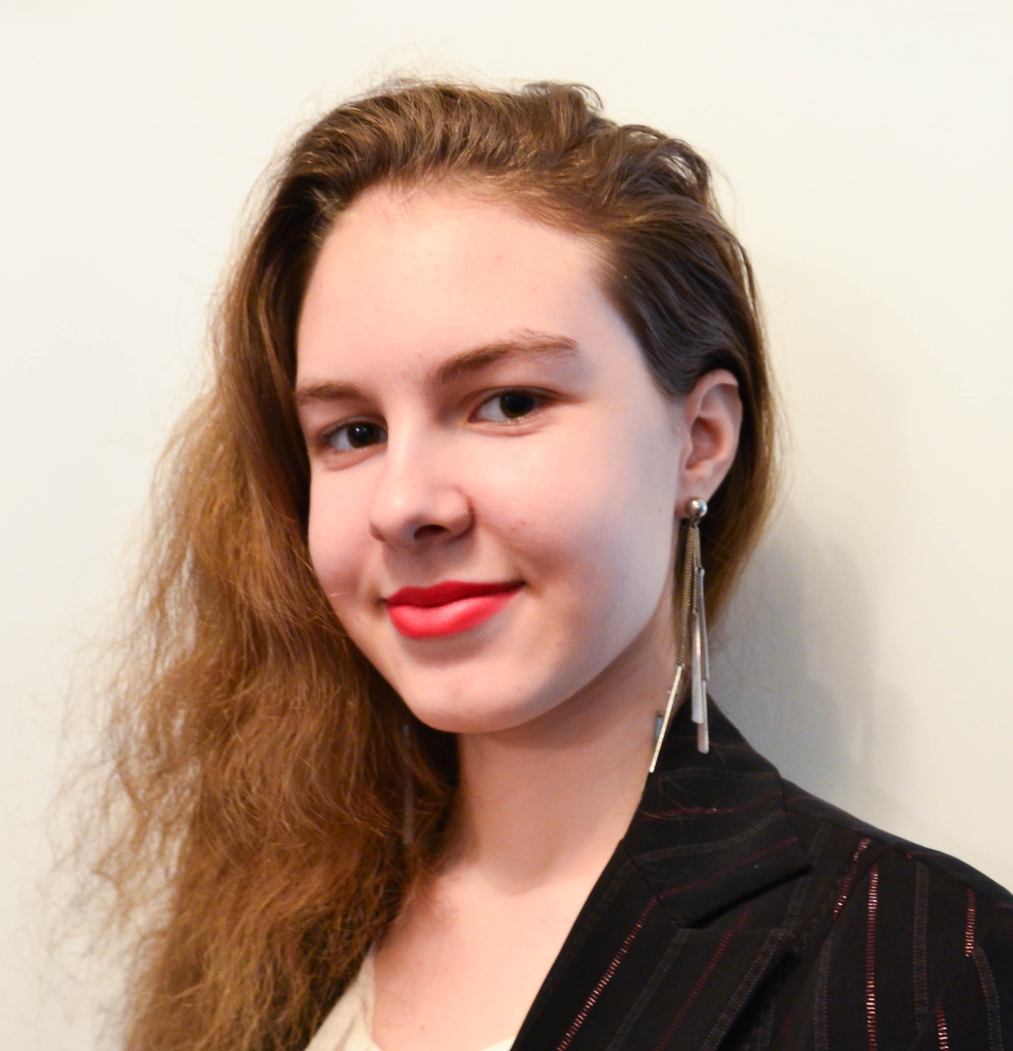
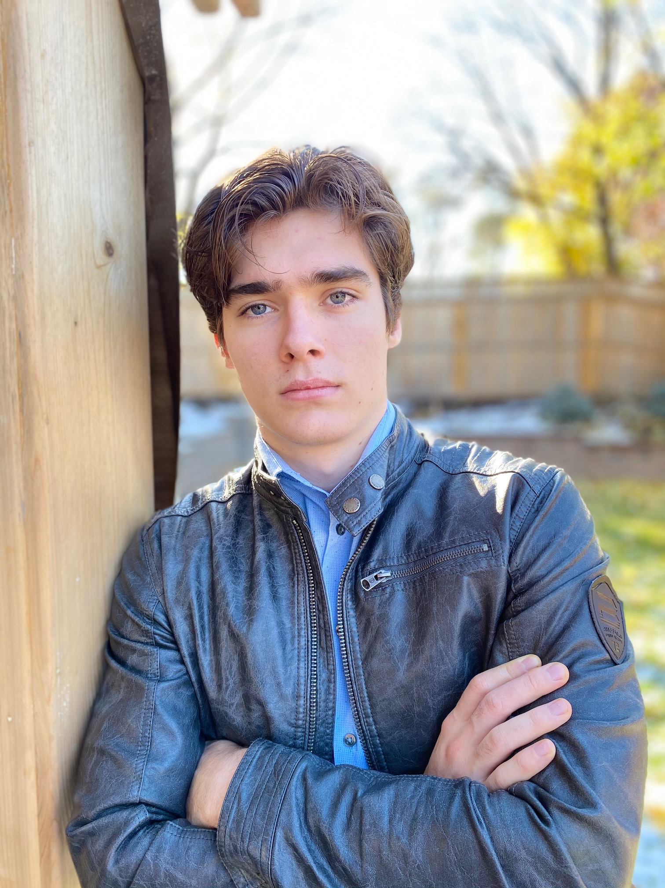

Svetlana Esina
Design specialist
Meet The Team
Daniel Andreev
Role
Jacob Pilon
Role

Slide 8

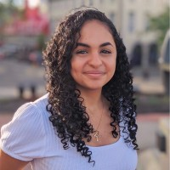
Jayden Bergevin
Design specialist
Meet The Team
Jean-Gabriel de Montigny
Role
Maryan Khalil
Financial Director

